Slide 1


Design Presentation on Credit Card Fraud Detection
Guided By: Presented By:
Dr. Manish Vyas Khushi Agrawal
Amay Saxena
Akshat Soni
Ameer Saif Khan

Slide 2
Contents
Technical Architecture
Sequence Diagram
Class Diagram
DFD
User Interface Design
Data Design
6.1 Schema Definition
6.2 E-R Diagram

Slide 3
1. Technical Architecture
What is Technical Architecture?
Technology architecture associates application components from application architecture with technology components representing software and hardware components.

Slide 4
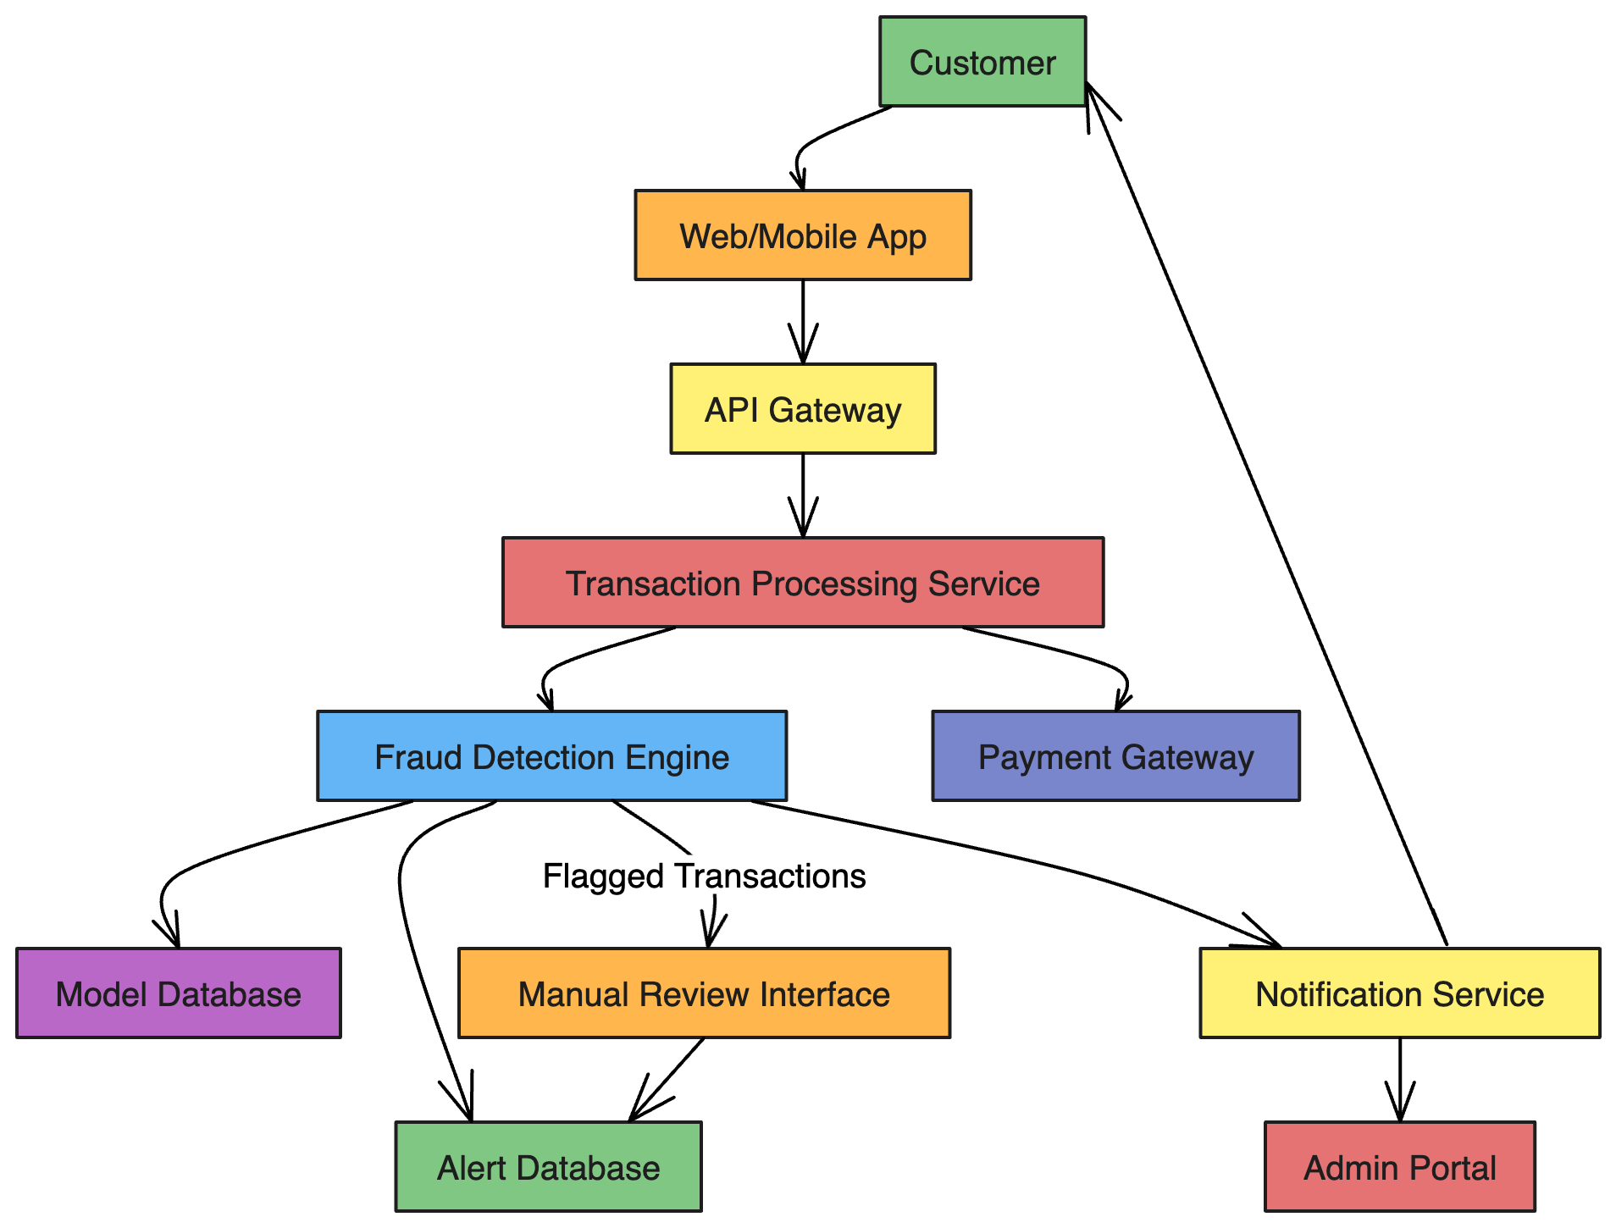

Slide 5
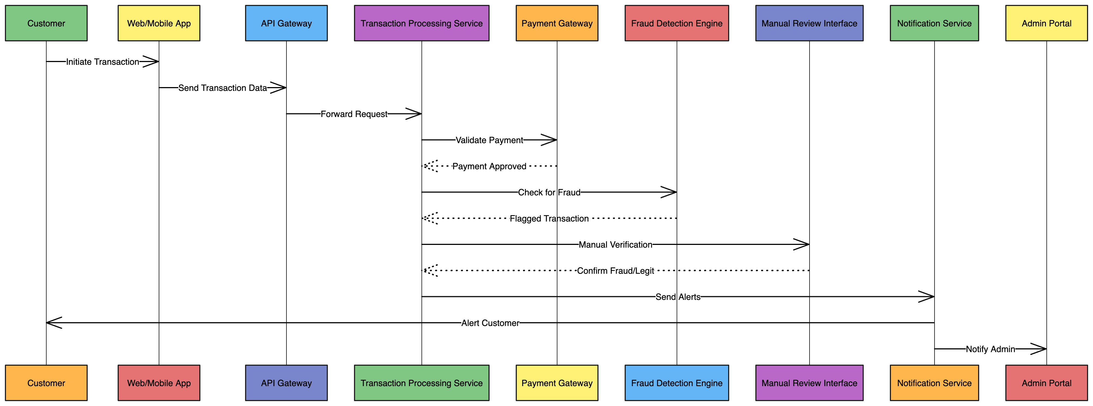
2. Sequence Diagram

Slide 6
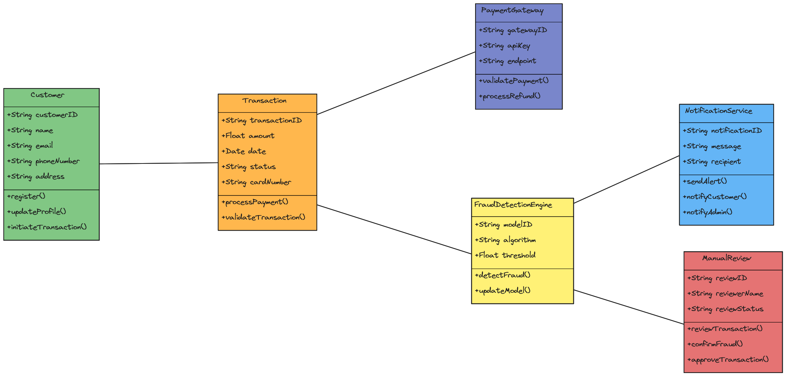
3. Class Diagram

Slide 7
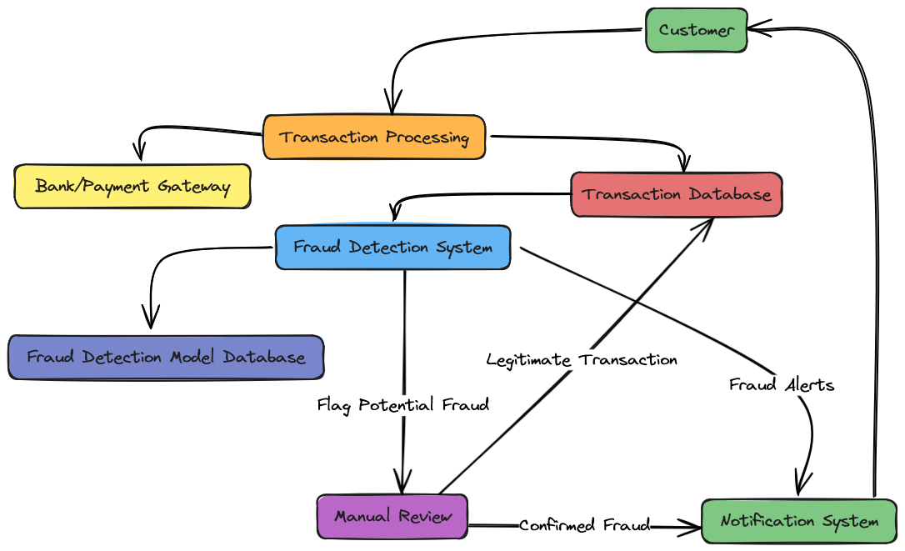
4. DFD (Data Flow Diagram)

Slide 8
5. User Interface (UI)

Slide 9
6. Data Design
6.1 Schema Definition
Data design is the process of organizing, storing, and managing data in a way that's efficient, accurate, and secure. A visual representation of how data is organized in a database. Schemas are created during the data modeling process.

Slide 10
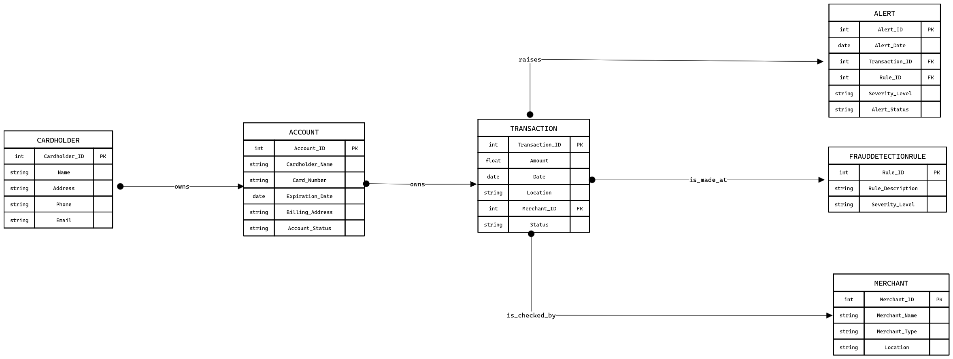
6. Data Design
6.2 E-R Diagram

